Slide 1
Section 13.3 - Truth in Lending
Determine the annual percentage rate for different types of loans.
Use the TVM Solver on the Calculator
Determine the monthly payment for a loan
Determine the Finance Charge for a loan

Slide 2
Truth in Lending
The Consumer Credit Protection Act, which
passed in 1968, has commonly been known as
the Truth in Lending Act. Two major issues are
addressed in the law:
1. How can I tell the true interest rate a lender is charging?
2. How much of the finance charge am I entitled to save if I decide to pay off a loan sooner than originally scheduled?

Slide 3
Annual Percentage Rate (APR)
Truth in Lending standardized the so-called annual interest rate, or annual percentage rate, commonly denoted APR.
All sellers must disclose the APR when you ask, and the contract must state the APR whether or not you ask.
We will utilize the TVM Solver on the calculator to compute the APR.

Slide 4

Example: Finding the APR for an Add-On Interest Loan
NOTE: Even though it says to use the APR table, we will be using the TVM Solver on the calculator. So, the “Help Me Solve This” and “View an Example” links will NOT show this method!
See Solution below
The Amount Financed is the Present Value. PV = 2900
To calculate the monthly payment (PMT), we need the Total Amount Owed = Amount Financed + Finance Charge
Total Amount Owed = 2900 + 272 = 3172
The monthly payment (PMT) is Total Owed ÷ Number of Monthly Payments
3172 ÷ 18 = $176.22 = PMT = – 176.22

Slide 5
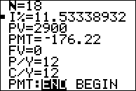
Example: Finding the APR for an Add-On Interest Loan
NOTE: Even though it says to use the APR table, we will be using the TVM Solver on the calculator. So, the “Help Me Solve This” and “View an Example” links will NOT show this method!
See Solution below (continued)
APR is the Interest rate (I) – Fill out all other lines first, then press ALPHA, ENTER
Number of monthly payments (N) is given
Present value (PV) is the Amount Financed. So you are getting money instead of paying money, it’s POSITIVE.
Monthly payment must be found by hand first (see previous slide)
Future Value (FV) for a loan is always zero!
Loans have monthly payments, or 12 payments per year (P/Y) and compoundings per year (C/Y).

Slide 6
Example: Finding the APR for an Add-On Interest Loan
NOTE: Even though it says to use the APR table, we will be using the TVM Solver on the calculator. So, the “Help Me Solve This” and “View an Example” links will NOT show this method!
See Solution below (continued)
For the MML questions, APR is rounded to the nearest half-percent.
x.00 – x.24 use x.0
x.25 – x.74 use x.5
x.75 – x.99 use x+1.0
(round up)
So, the APR is 11.5%

Slide 7

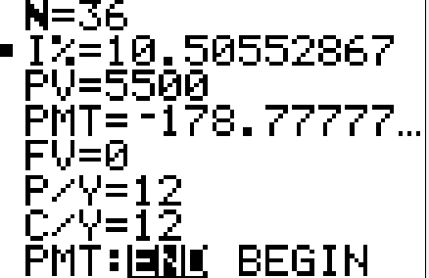

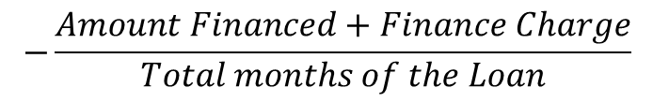
Example: Finding the APR for an Add-On Interest Loan – Calculator Method
So, the APR is 10.5%
$5500 financed (purchase price)
PMT (monthly payment): be sure to make negative.
- (5500 + 936) / 36
$$−\frac{Amount Financed+Finance Charge}{Total months of the Loan}$$
Payments are made monthly.

Slide 8
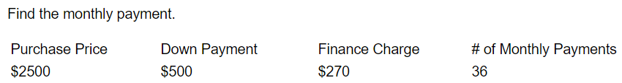
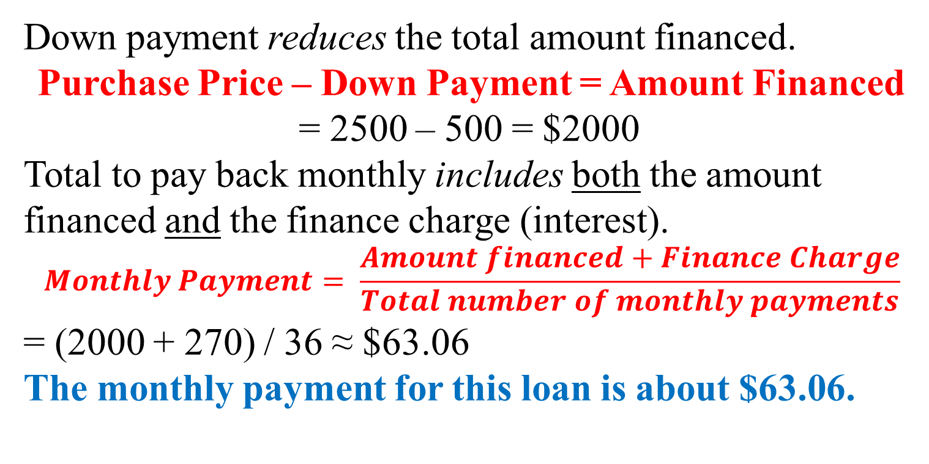
Example: Finding the Monthly Payment
Solution
Down payment reduces the total amount financed.
Purchase Price – Down Payment = Amount Financed
= 2500 – 500 = $2000
Total to pay back monthly includes both the amount financed and the finance charge (interest).
$$Monthly Payment= \frac{Amount financed+Finance Charge}{Total number of monthly payments}$$
= (2000 + 270) / 36 ≈ $63.06
The monthly payment for this loan is about $63.06.

Slide 9
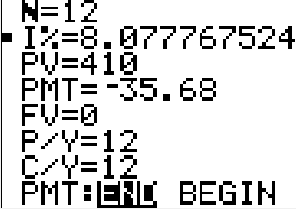
Example: Determine the Finance Charge and APR of a loan – no down payment
Solution
The total amount paid back is simply $35.68 × 12 = $428.16.
When you subtract off the purchase price, you have the finance charge (interest): $428.16 – $410 = $28.16 = finance charge
Next, we use the TVM Solver on the calculator to get the APR:
So, the APR for this loan, rounded to the nearest half-percent, is 8%

Slide 10
Example: Determine the Finance Charge and APR of a loan – with down payment
Solution
The down payment reduces the amount financed:
Purchase Price – Down Payment = Amount Financed
$19,900 – $3500 = $16,400 = Amount Financed
The total amount paid back is simply $340 × 60 = $20,400.
Total Paid Back – Amount Financed = Finance Charge
$20,400 – $16,400 = $4,000 = finance charge
Next, we use the TVM Solver on the calculator to get the APR:

Slide 11
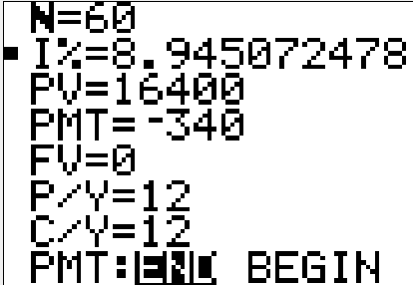
Example: Determine the Finance Charge and APR of a loan – with down payment
Monthly Payment of $340 is given in the problem.
PV: Purchase Price – Down Payment = 19,900 – 3,500 = 16,400
So, the APR for this loan, rounded to the nearest half-percent, is 9%

